Slide 1
DNS

Slide 2
What is DNS?
Problem: Network only understands numeric addresses
Solution:
  Use alphanumeric names to refer to hosts and then:
  Add a distributed, hierarchical protocol (called DNS) to map between alphanumeric host names and IP addresses

Slide 3
What is DNS?
Internet Directory Service
A client-server application that maps host names into their corresponding IP addresses
Mapping host names into their corresponding IP addresses is called name resolution or name translation or name mapping or Address Resolution
Why we need to use names instead of IP numbers?
Because…
Because…
Notes:
IP addresses are difficult to remember
IP addresses can change

Slide 4
DNS Components
  The name space
  The servers
  The resolvers
DNS Structure and Hierarchy

Slide 5
NAME SPACE
IP addresses are unique → Host names must be unique
How to manage this large number of names? Where ?
Centralized? → inefficient & unreliable
  why?
    Heavy traffic because of requests from all over the world
    Failure makes data un-available
    Hard to maintain
Thus, DNS record database is distributed.
2: Application Layer

Slide 6
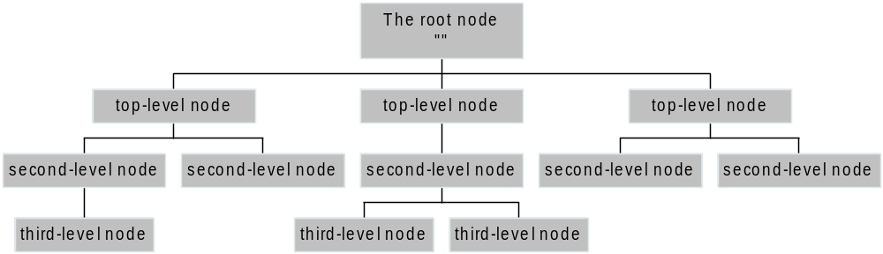
The Name Space
The name space is the structure of the DNS database
  An inverted tree with the root node at the top
Each node has a label
  The root node has a null label, written as “”

Slide 7
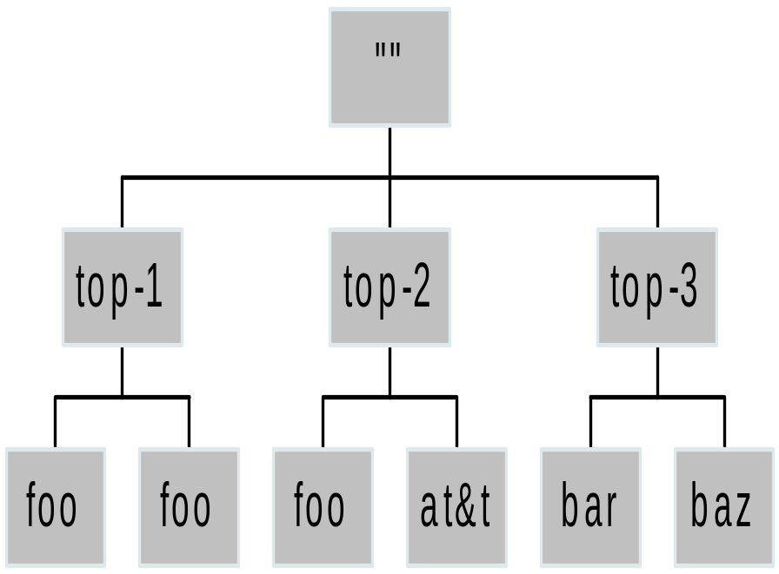
Labels
Each node in the tree must have a label
  A string of up to 63 bytes
  legal characters for “hostnames”:
    A-Z, 0-9, and “-” only with a-z and A-Z treated as the same
Note:
Sibling nodes must have unique labels
The null label is reserved for the root node

Slide 8
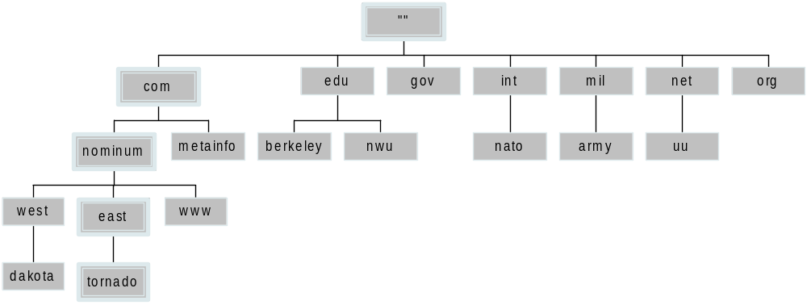
Domain Names
A domain name is the sequence of labels from a node to the root, separated by dots (“.”s), read left to right
  The name space has a maximum depth of 127 levels
  Domain names are limited to 255 characters in length
A node’s domain name identifies its position in the name space

Slide 9
Subdomains
One domain is a subdomain of another if its domain name ends in the other’s domain name
  So sales.nominum.com is a subdomain of
    nominum.com & com
  nominum.com is a subdomain of com

Slide 10
Delegation
Administrators can create subdomains to group hosts
  According to geography, organizational affiliation etc.
An administrator of a domain can delegate responsibility for managing a subdomain to someone else
The parent domain retains links to the delegated subdomains

Slide 11
Delegation Creates Zones
Each time an administrator delegates a subdomain, a new unit of administration is created
  The subdomain and its parent domain can now be administered independently
  These units are called zones
  The boundary between zones is a point of delegation in the name space
If the authoritative server for a zone is not also authoritative for its parent zone, the server for the parent zone must be configured with a delegation for the zone
Delegation is good: it is the key to scalability

Slide 12
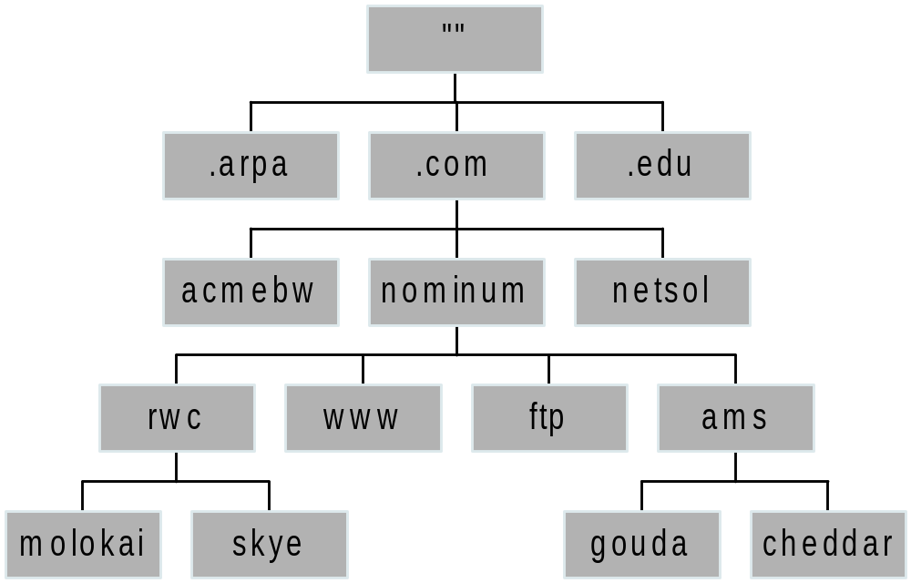
Dividing a Domain into Zones
nominum.com domain
nominum.com zone
ams.nominum.com zone
rwc.nominum.com zone

Slide 13
“Authoritative” Name Servers
Name servers store information about the name space in units called “zones”
  The name servers that load a complete zone are said to “have authority for” or “be authoritative for” the zone
Every domain name appears in a zone served by one or more authoritative name servers.
  This ensures redundancy and spreads the load
Also, a single name server may be authoritative for many zones

Slide 14
Name Servers and Zones
128.8.10.5 serves data for both nominum.com and isc.org zones
Name Servers
Zones
128.8.10.5
nominum.com
202.12.28.129 serves data for nominum.com zone only
202.12.28.129
isc.org
204.152.187.11 serves data for isc.org zone only
204.152.187.11

Slide 15
Types of Name Servers
Two main types of servers
  Authoritative – maintains the data
    Master – where the data is edited
    Slave – where data is replicated to
  Caching – stores data obtained from an authoritative server
No special hardware necessary
Notes:
BIND: Berkeley Internet Name Domain

Slide 16
Name Server Architecture
You can think of a name server as part of:
  Database server, answering queries about the parts of the name space it knows about (i.e., is authoritative for),
  Cache, temporarily storing data it learns from other name servers, and
  Agent, helping resolvers and other name servers find data
Notes:
Also, the caching resolver can insert data into the cache, and can "query" the cache and the database server.

Slide 17
Name Server Architecture
Zone
data
file
Name Server Process
From
disk
Authoritative Data
(primary master and
slave zones)
Master
server
Zone transfer
Cache Data
(responses from
other name servers)
Agent
(looks up queries
on behalf of resolvers)

Slide 18
Authoritative Data
Name Server Process
Authoritative Data
(primary master and
slave zones)
Response
Cache Data
(responses from
other name servers)
Agent
(looks up queries
on behalf of resolvers)
Resolver
Query

Slide 19
Using Other Name Servers
Name Server Process
Authoritative Data
(primary master and
slave zones)
Cache Data
(responses from
other name servers)
Response
Response
Another
name
server
Agent
(looks up queries
on behalf of resolvers)
Query
Resolver
Query

Slide 20
Cached Data
Name Server Process
Authoritative Data
(primary master and
slave zones)
Response
Cache Data
(responses from
other name servers)
Agent
(looks up queries
on behalf of resolvers)
Query
Resolver

Slide 21
Name Resolution
This is the process by which resolvers and name servers cooperate to find data in the name space
Closure mechanism for DNS?
  Starting point: the names and IP addresses of the name servers for the root zone (the “root name servers”)
  The root name servers know about the top-level zones and can tell name servers whom to contact for all TLDs

Slide 22
Name Resolution
A DNS query has three parameters:
  A domain name (e.g., www.nominum.com),
    Remember, every node has a domain name!
  A class (e.g., IN), and
  A type (e.g., A)
    http://network-tools.com/nslook/
Upon receiving a query from a resolver, a name server
  1) looks for the answer in its authoritative cache
  2) If step 1 fails, the answer must be looked up

Slide 23
The Resolution Process
Let’s look at the resolution process step-by-step:
annie.west.sprockets.com
ping www.nominum.com.

Slide 24
The Resolution Process
The workstation annie asks its resolving name server(also called Configured name server), dakota, for www.nominum.com’s address
dakota.west.sprockets.com
What’s the IP address of www.nominum.com?
annie.west.sprockets.com
ping www.nominum.com.

Slide 25
The Resolution Process
The name server dakota asks a root name server, m, for www.nominum.com’s address
m.root-servers.net
dakota.west.sprockets.com
What’s the IP address of www.nominum.com?
annie.west.sprockets.com
ping www.nominum.com.

Slide 26
The Resolution Process
The root server m refers dakota to the com name servers
This type of response is called a “referral”
m.root-servers.net
dakota.west.sprockets.com
Here’s a list of the com name servers. Ask one of them.
annie.west.sprockets.com
ping www.nominum.com.

Slide 27
The Resolution Process
The name server dakota asks a com name server, f, for www.nominum.com’s address
What’s the IP address of www.nominum.com?
m.root-servers.net
dakota.west.sprockets.com
f.gtld-servers.net
annie.west.sprockets.com
ping www.nominum.com.

Slide 28
The Resolution Process
The com name server f refers dakota to the nominum.com name servers
Here’s a list of the nominum.com name servers. Ask one of them.
m.root-servers.net
dakota.west.sprockets.com
f.gtld-servers.net
annie.west.sprockets.com
ping www.nominum.com.

Slide 29
The Resolution Process
The name server dakota asks a nominum.com name server, ns1.sanjose, for www.nominum.com’s address
What’s the IP address of www.nominum.com?
m.root-servers.net
dakota.west.sprockets.com
ns1.sanjose.nominum.net
f.gtld-servers.net
annie.west.sprockets.com
ping www.nominum.com.

Slide 30
The Resolution Process
The nominum.com name server ns1.sanjose responds with www.nominum.com’s address
m.root-servers.net
dakota.west.sprockets.com
Here’s the IP address for www.nominum.com
ns1.sanjose.nominum.net
f.gtld-servers.net
annie.west.sprockets.com
ping www.nominum.com.

Slide 31
The Resolution Process
The name server dakota responds to annie with www.nominum.com’s address
Here’s the IP address for www.nominum.com
m.root-servers.net
dakota.west.sprockets.com
ns1.sanjose.nominum.net
f.gtld-servers.net
annie.west.sprockets.com
ping www.nominum.com.

Slide 32
Resolution Process (Caching)
After the previous query, the name server dakota now knows:
  The names and IP addresses of the com name servers
  The names and IP addresses of the nominum.com name servers
  The IP address of www.nominum.com
Let’s look at the resolution process again
annie.west.sprockets.com
ping ftp.nominum.com.

Slide 33
Resolution Process (Caching)
The workstation annie asks its configured name server, dakota, for ftp.nominum.com’s address
m.root-servers.net
dakota.west.sprockets.com
What’s the IP address of ftp.nominum.com?
ns1.sanjose.nominum.net
f.gtld-servers.net
annie.west.sprockets.com
ping ftp.nominum.com.

Slide 34
Resolution Process (Caching)
dakota has cached a NS record indicating ns1.sanjose is an nominum.com name server, so it asks it for ftp.nominum.com’s address
What’s the IP address of ftp.nominum.com?
m.root-servers.net
dakota.west.sprockets.com
ns1.sanjose.nominum.net
f.gtld-servers.net
annie.west.sprockets.com
ping ftp.nominum.com.

Slide 35
Resolution Process (Caching)
The nominum.com name server ns1.sanjose responds with ftp.nominum.com’s address
m.root-servers.net
dakota.west.sprockets.com
Here’s the IP address for ftp.nominum.com
ns1.sanjose.nominum.net
f.gtld-servers.net
annie.west.sprockets.com
ping ftp.nominum.com.

Slide 36
Resolution Process (Caching)
The name server dakota responds to annie with ftp.nominum.com’s address
Here’s the IP address for ftp.nominum.com
m.root-servers.net
dakota.west.sprockets.com
ns1.sanjose.nominum.net
f.gtld-servers.net
annie.west.sprockets.com
ping ftp.nominum.com.

Slide 37
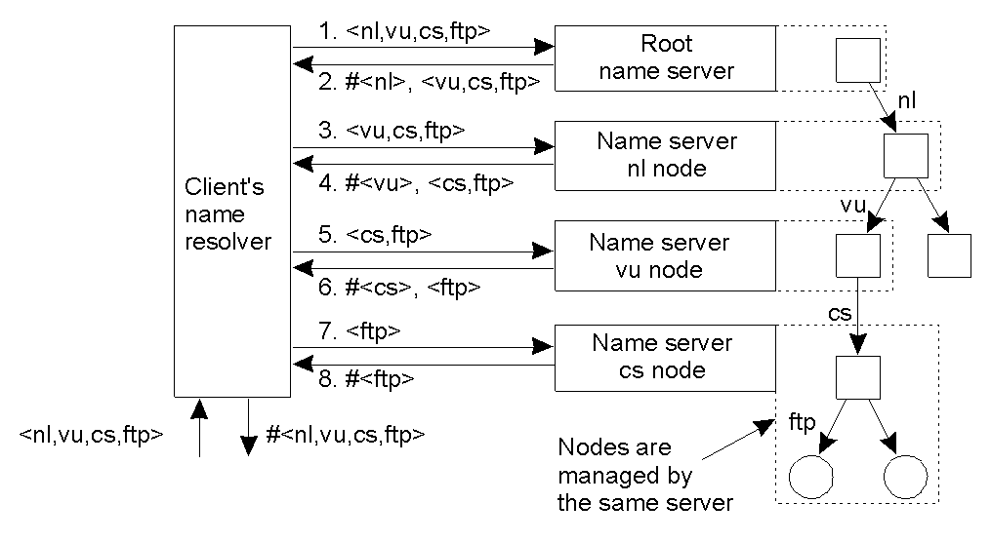
Iterative Name Resolution
The principle of iterative name resolution.

Slide 38
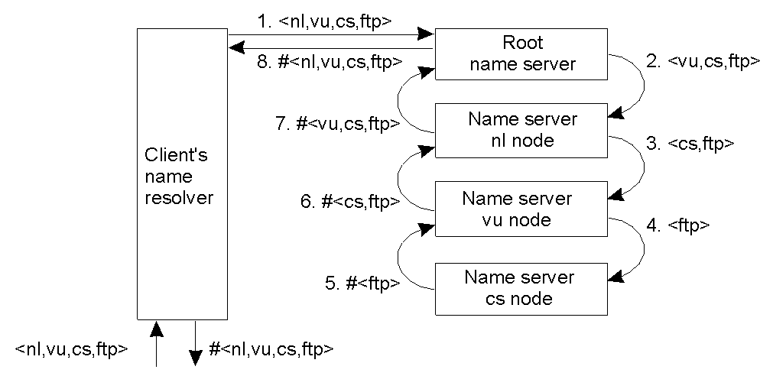
Recursive Name Resolution
The principle of recursive name resolution.

Slide 39
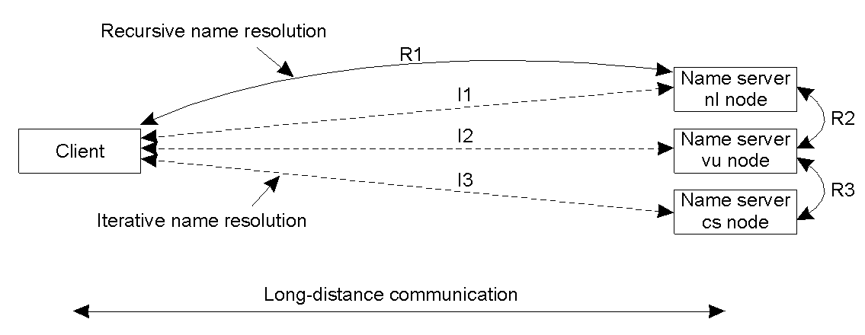
Iterative versus Recursive Resolution
The comparison between recursive and iterative name resolution with respect to communication costs.

Slide 40
DNS Structure and Hierarchy
The DNS imposes no constraints on how the DNS hierarchy is implemented except:
  A single root
  The label restrictions
  So, can we create a host with a name a.wonderful.world?
If a site is not connected to the Internet, it can use any domain hierarchy it chooses
  Can make up whatever TLDs (top level domains) you want
Connecting to the Internet implies use of the existing DNS hierarchy

Slide 41
Top-level Domain (TLD) Structure
A top-level domain (TLD) is one of the domains at the highest level in the hierarchical Domain Name System of the Internet
  The top-level domain names are installed in the root zone of the name space.
For all domains in lower levels, it is the last part of the domain name, that is, the label that follows the last dot of a fully qualified domain name
  In the domain name www.jiit.ac.in, the top-level domain is in.
Top-level domain (TLD) servers: responsible for com, org, net, edu, etc, and all top-level country domains uk, fr, ca, jp.
Notes:
ARPA: Advanced Research Projects Agency

Slide 42
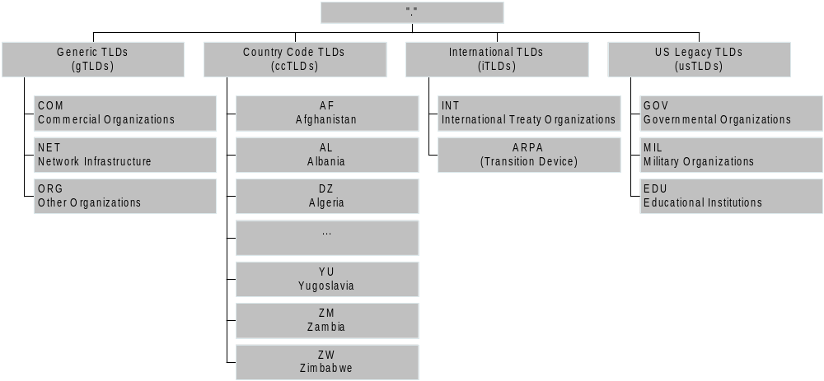
The Current TLDs

Slide 43
Authoritative DNS Servers
Organization’s DNS servers, providing authoritative hostname to IP mappings for organization’s servers (e.g., Web and mail).
    Can be maintained by organization or service provider
  A Root Name Server(name server for the root zone of the DNS) will:
    Directly answer requests for records in the root zone
    Answer other requests by returning a list of the authoritative name servers for the appropriate top-level domain (TLD).

Slide 44
Authoritative DNS Servers
An authoritative name server that gives answers in response to questions asked about names in a zone
Returns answers only to queries about domain names that have been specifically configured by the administrator
Name servers can also be configured to give authoritative answers to queries in some zones, while acting as a caching name server for all other zones
  An authoritative name server can either be a primary server (master) or a secondary server (slave)
Every domain name appears in a zone served by one or more authoritative name servers

Slide 45
Registries, Registrars, and Registrants
A classification of roles in the operation of a domain name space
Registry
  The name space’s database
  The organization which has edit control of that database
  The organization which runs the authoritative name servers for that name space
Registrar
  The agent which submits change requests to the registry on behalf of the registrant
Registrant
  The entity which makes use of the domain name

Slide 46
Registries, Registrars, and Registrants
Registry updates
zone
Master
updated
Registry
Zone DB
Registrar submits
add/modify/delete
to registry
Slaves
updated
Registrar
Registrar
Registrar
End user requests
add/modify/delete
Registrants

Slide 47
DNS records
DNS: distributed db storing resource records (RR)
RR format: (name, value, type, ttl)
Type=A (used for local DNS servers)
  name is hostname
  value is IP address
e.g. (relay1.bar.foo.com, 145.37.93.126, A, ttl)
Type=CNAME (used for auth./TLD servers)
  name is alias name for some “canonical” (the real) name
  e.g. www.ibm.com is really
  servereast.backup2.ibm.com
  value is canonical name
  e.g. (foo.com, relay1.bar.foo.com, CNAME, ttl)
Type=NS (used for auth. servers)
  name is domain (e.g. foo.com)
  value is hostname of authoritative name server for this domain
e.g. (foo.com, dns.foo.com, NS, ttl)
Canonical hostname
Type=MX(used for email applications)
  value is cannonical name of mailserver associated with name
  e.g. (foo.com, mail.bar.foo.com, MX, ttl)
2: Application Layer

Slide 48

DNS protocol, messages
DNS protocol : query and reply messages, both with same message format
Msg Header
identification: 16 bit # for query, reply to query uses same #
flags:
  query or reply
  recursion desired
  recursion available
  reply is authoritative
2: Application Layer

Slide 49
DNS protocol, messages
Name, type fields
for a query
RRs in response
to query
records for
authoritative servers
additional “helpful”
info that may be used
2: Application Layer

Slide 50
Inserting records into DNS
Example: just created startup “Network Utopia”
Register name networkuptopia.com at a registrar (e.g., Network Solutions)
  Need to provide registrar with names and IP addresses of your authoritative name server (primary and secondary)
  Registrar inserts two RRs into the com TLD server:
  (networkutopia.com, dns1.networkutopia.com, NS)
  (dns1.networkutopia.com, 212.212.212.1, A)
Put in authoritative server Type A record for www.networkuptopia.com and Type MX record for mail.networkutopia.com
How do people get the IP address of your Web site?
2: Application Layer

